Slide 1
Clicker Database Design and Implementation
Advanced System Project: class 2021

Slide 2

Database used
SQL Server System Management Studio
DB_111206_clicker

Slide 3
Tables
Player – Stores all the information about the player
Inventory - Stores all the items the players have and the amount of them
Items - stores all the items in the game (their name, icon, calc string (the function to calculate the time it takes for the game to complete )
Goals - the global game goals
Goal_Items - items and the amount required to meet a goal.
Player_to_Goals - translation table in game goals
GameStat – holds gamestat data and put it into cache
PlayerStat – Store total amount played

Slide 4
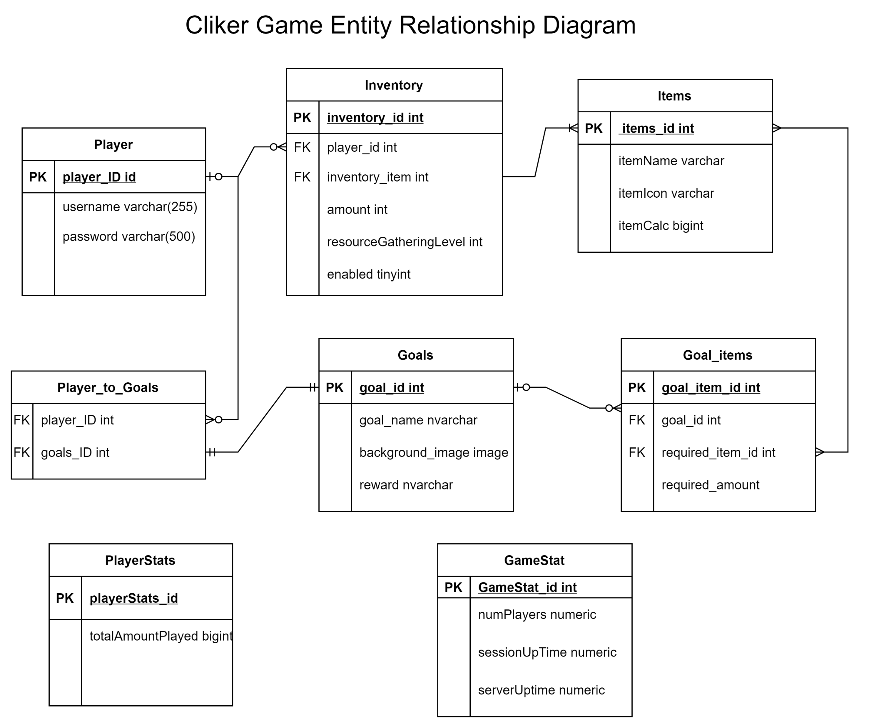
ERD (app.diagrams.net)
Relationships
One to one option
One to many
Many to Many

Slide 5
Project Descriptions
Create tables that store data of the game.
Creates Stored procedures to be called anytime needed.
Also defines Custom Data types to pass everything. Ex: Inventory table
Objective

Slide 6
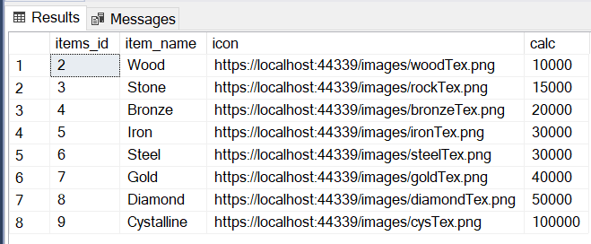
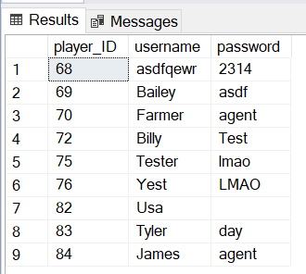
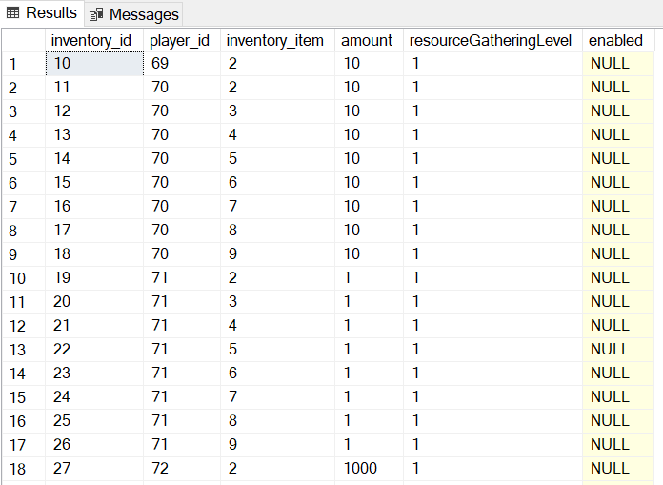
Check and implement correct Normalization
Examples
First Normal Form:
Each table cell should contain a single value.
Each record needs to be unique

Slide 7
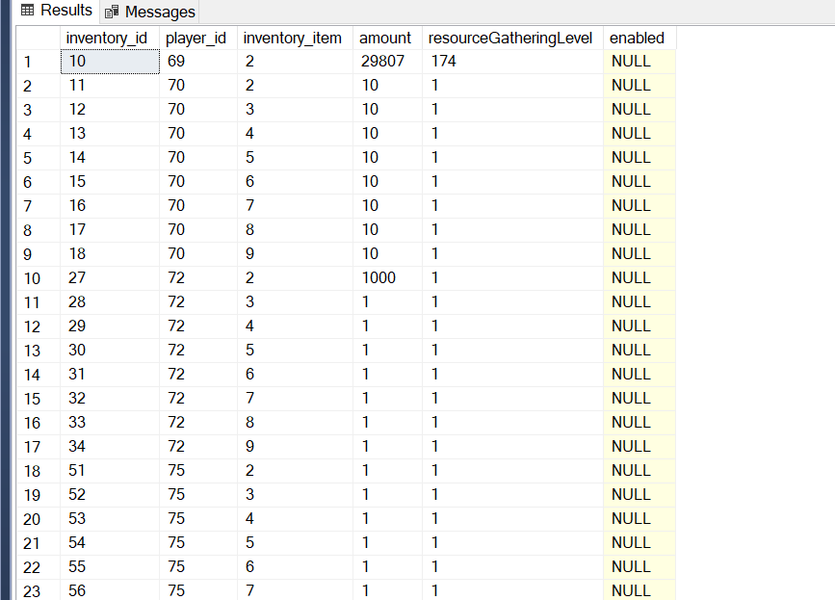
Normalization(continues…)
Second Normal Form:
Should be in First normal form.
Should have a single column primary key (Primary key will be used to identify a record in a table uniquely).

Slide 8
Normalization (continue…)
for every ACTOR_ID value, there can be only one (functionally dependent) FIRST_NAME and LAST_NAME value.
Third Normal Form:
Be in Second normal form
Functional dependence
Example: Given a player_ID, we can determine any of the other attributes values(username and password)

Slide 9
Thank you
God Bless You All!

